Slide 1
Evolutionary Computing
Chapter 13
Constraint Handling

Slide 2
Constraint Handling
Motivation and the trouble
What is a constrained problem?
Constraint handling in EAs
transforming constraints into an objectives BEFORE running the EA
taking care that the constraint is respected DURING running the EA

Slide 3
Motivation
Why bother about constraints?
Practical relevance:
a great deal of practical problems are constrained.
Theoretical challenge:
a great deal of untractable problems (NP-hard etc.) are constrained.
Why try with evolutionary algorithms?
EAs show a good ratio of (implementation) effort/performance.
EAs are acknowledged as good solvers for tough problems.

Slide 4
What is a constrained problem?
Consider the Travelling Salesman Problem for n cities, C = {city₁, … , city_{n}}
If we define the search space as
S = C^{n}, then we need a constraint requiring uniqueness of each city in an element of S
S = {permutations of C}, then we need no additional constraint.
The notion ‘constrained problem’ depends on what we take as search space

Slide 5
What is constrained search? Or What is free search?
Even in the space S = {permutations of C} we cannot perform free search
Free search: standard mutation and crossover preserve membership of S, i.e., mut(x) ∈ S and cross(x,y) ∈ S
The notion ‘free search’ depends on what we take as standard mutation and crossover.
mut is standard mutation if for all ⟨x₁, … , x_{n}⟩, if mut(⟨x1, … , xn⟩) = ⟨ x’1, … , x’n⟩, then x’i ∈ domain(i)
cross is standard crossover if for all ⟨x1, … , xn⟩, ⟨y1, … , yn⟩, if cross(⟨x1, … , xn⟩, ⟨y1, … , yn⟩) = ⟨z1, … , zn⟩, then
zi ∈ {xi, yi} discrete case
zi ∈ [xi, yi] continuous case
These are very light (non-restrictive) conditions

Slide 6
Free search space
Free search space: S = D₁ × … × D_{n}
one assumption on D_{i}: if it is continuous, it is convex
the restriction s_{i} ∈ D_{i} is not a constraint, it is the definition of the domain of the i-th variable
membership of S is coordinate-wise, hence a free search space allows free search
A problem can be defined through
an objective function (to be optimized)
constraints (to be satisfied)

Slide 7
Problem categorization schemes
Recall the 3 schemes discussed in Chapter 1
Optimization – modeling – simulation scheme (where is the ?)
FOP – COP – CSP scheme (2 x 2 matrix)
NP scheme (based on solver properties)

Slide 8
Optimisation vs. constraint satisfaction
 | Objective function
Constraints | Yes | No
Yes | Constrained Optimisation Problem | Constraint Satisfaction Problem
No | Free Optimisation Problem | No problem ☺
Constraint vs. Constrained

Slide 9
Free Optimization Problems
Free Optimization Problem: ⟨S, f, •⟩
S is a free search space
f is a (real valued) objective function on S
Solution of an FOP: s ∈ S such that f (s) is optimal in S
FOPs are ‘easy’, in the sense that:
it's ‘only’ optimizing, no constraints and
EAs have a basic instinct for optimization

Slide 10
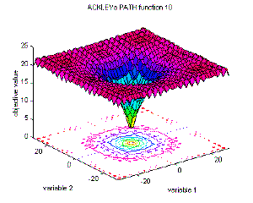
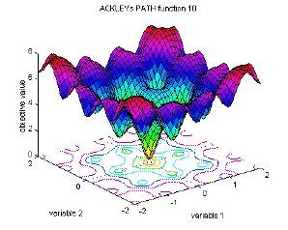
FOP: Example
Ackley function

Slide 11
Constraint Satisfaction Problems (1/2)
Constraint Satisfaction Problem: ⟨S, •, Φ⟩
S is a free search space
Φ is a formula (Boolean function on S)
Φ is the feasibility condition
S_{Φ} = {s ∈ S | Φ(s) = true} is the feasible search space
Solution of a CSP:
s ∈ S such that Φ(s) = true (s is feasible)

Slide 12
Constraint Satisfaction Problems (2/2)
Φ is typically given by a set (conjunction) of constraints
c_{i} = c_{i}(x_{j1}, … , x_{jni}), where n_{i} is the arity of c_{i}
c_{i} ⊆ D_{j1} × … × D_{jni} is also a common notation
FACTS:
The general CSP is NP-complete
Every CSP is equivalent with a binary CSP, where all n_{i} = 2
Constraint density and constraint tightness are parameters that determine how hard an instance is

Slide 13
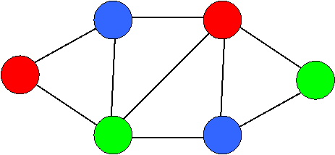
CSP: Example
Graph 3-coloring problem:
G = (N, E), E ⊆ N × N , |N| = n
S = D^{n}, D = {1, 2, 3}
Φ(s) = Λ_{e∈E} c_{e}(s), where
c_{e}(s) = true iff e = (k, l) and s_{k} ≠ s_{l}

Slide 14
Constrained optimization problems
Constrained Optimization Problem: ⟨S, f, Φ⟩
S is a free search space
f is a (real valued) objective function on S
Φ is a formula (Boolean function on S)
Solution of a COP:
s ∈ S_{Φ} such that f(s) is optimal in S_{Φ}

Slide 15
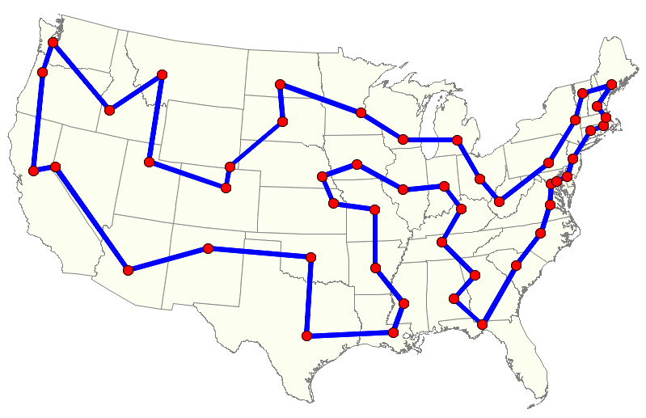
COP: Example
Travelling salesman problem
S = C^{n}, C = {city₁, … , city_{n}}
Φ(s) = true ⇔ ∀i, j ∈ {1, … , n} i ≠ j ⇒ s_{i} ≠ s_{j}
f(s) =

Slide 16
Solving CSPs by EAs
EAs need an f to optimize, thus ⟨S, •, Φ⟩ must be transformed to a
FOP, then the transformation is ⟨S, •, Φ⟩ → ⟨S, f, •⟩ all constraints become objectives
or
COP, then the transformation is ⟨S, •, Φ⟩ → ⟨S, f, Ψ ⟩ some constraints become objectives, but not all
The transformation must be (semi-)equivalent, i.e. at least:
If f(s) is optimal in S then Φ(s) = true
If ψ(s) = true and f (s) is optimal in S then Φ(s) = true

Slide 17
Direct vs. indirect constraint handling
Indirect constraint handling:
Transforming the constraint into an objective
This happens BEFORE running the EA (to create an f)
Direct constraint handling:
Taking care that the constraint is respected
This happens DURING running the EA
A CSP → FOP transformation means all constraints are handled indirectly
A CSP → COP transformation means some constraints are handled indirectly, and some are handled directly

Slide 18
Indirect constraint handling
Note: always needed when solving CSPs
because it has no objective f in itself
for all constraints when using a CSP → FOP transformation
for some constraints when using a CSP → COP transformation (those that get transformed into an objective)
Some general options for indirect constraint handling:
a. penalty for violated constraints
b. penalty for wrongly instantiated variables
c. estimating distance/cost to feasible solution

Slide 19
Indirect constraint handling
Notation:
c_{i} constraints, i = {1, … , m}
v_{j} variables, j = {1, … , n}
C^{j} is the set of constraints involving variable v_{j}
S_{c} = {z ∈ D_{j1} × … × D_{jk} | c(z) = true} is the projection of c, if v_{j1}, … , v_{jk} are the var's of c
d(s, S_{c}) := min{d(s, z) | z ∈ 2 S_{c}} is the distance of s ∈ S from S_{c} (s is projected to)

Slide 20
Indirect constraint handling
Formally:
Note: we sum over all constraints 1, …, m
Note: we sum over all variables 1, …, n
Note: we sum over all constraints 1, …, m
d(s, S_{c}) is as defined before
Observe that for each option:

Slide 21
Special case: graph coloring example

Slide 22
Indirect constraint handling: pro’s & con’s
PRO’s of indirect constraint handling:
conceptually simple, transparent
problem independent
reduces problem to ‘simple’ optimization
allows user to express preferences by different weights for different violations (weight per constraint or per variable)
allows EA to tune fitness function by modifying weights during the search
CON’s of indirect constraint handling:
loss of info by packing everything in a single number
said not to work well for sparse problems

Slide 23
Direct constraint handling
Options:
eliminating infeasible candidates (very inefficient, hardly practicable)
repairing infeasible candidates (problem specific, may or may not be possible/easy)
preserving feasibility by special mutation / crossover operators (requires feasible initial population)
decoding, i.e. transforming the search space (allows usual representation and operators)
Q: which of these did you see in the N-queens example ?

Slide 24
Direct constraint handling
PRO's of direct constraint handling:
it works well (except eliminating)
CON's of direct constraint handling:
problem specific
no guidelines

Slide 25
Important points
Constraints are “everywhere”
FOP – CSP – COP scheme
Indirect constraint handling: make it an objective BEFORE the EA is applied
Direct constraint handling: take care of it DURING the EA run

